Slide 1
AtliQ Hardware: Sales Analytics

Slide 2
AtliQ Hardware Business Model
Company sells hardware products like PCs, Mouse, Keyboard, Printers etc. to different customers
Customers include:
Retail stores like Croma, Best Buy etc. (Brick & Mortar Customer)
Online platforms like Flipkart, Amazon etc. (E Commerce Customer)
The stores(AtliQ’s customers) eventually sell the products to the end consumers. (Retailer Chanel)
Alongside 3rd party Retail stores AtliQ also has its own store: AtliQ E store and AtliQ Exclusive to sell directly to consumers (Direct Chanel)
In Certain countries like China due to government regulations AtliQ cannot directly sell its products to Customers rather has to sell to a distributer (e.g. Neptune)
The distributer then sells the hardware items to different local stores (Distributer Chanel) .
So AtliQ has three different channels:
Retailer
Direct
Distributer

Slide 3
Business Requirement
Create a Customer Performance Report to analyze the sales figures of all the Customers over a period from 2019 to 2021.
Find out the percentage growth in sales from 2020 to 2021

Slide 4
An Insight on the data Provided
Dim Tables
dim_customer.csv – contains Customer code, Customer name including distributers, retailers and own stores, Market, platform ( e com or Brick & Mortar) and Chanel (Direct, Distributer or Retailer)
dim_market.csv – contains Market, Sub Zone and Region
dim_product.csv – contains Product_code, Division, Segment, Category, Product, Variant
Fact Table
fact_sales_monthly.csv –

Slide 5

Steps Performed
Extract Transform Load (ETL)
Extract
Transform
Load
Extract
Import Sales data csv files into Excel
Transform
Use Power Query to perform transformations on the loaded files inside excel
csv
Power Query
csv
Sales Data
csv
csv
Load
Load the transformed sales data back to Excel into different sheets
* The transformed fact and dim tables have been added to the data model

Slide 6
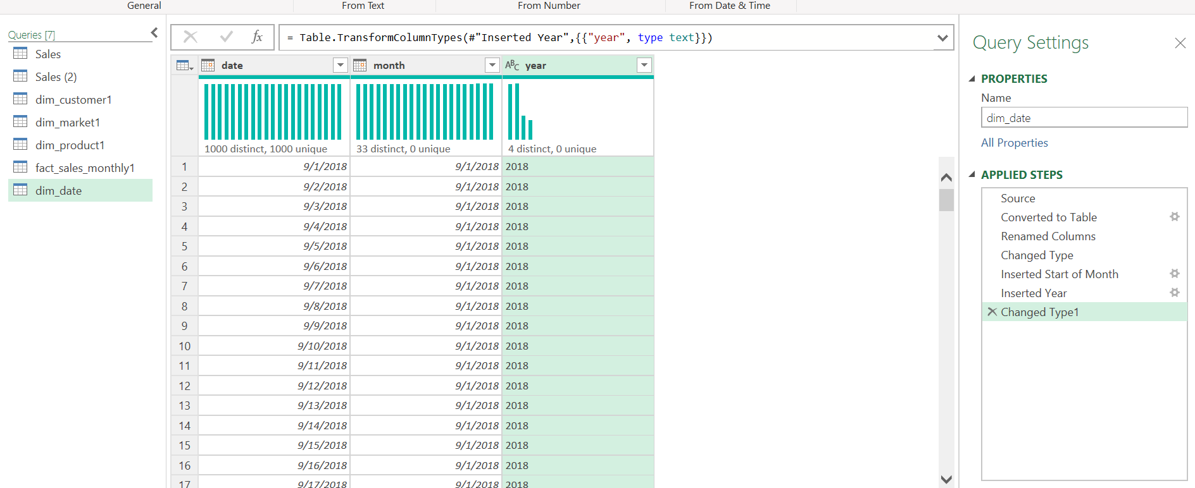
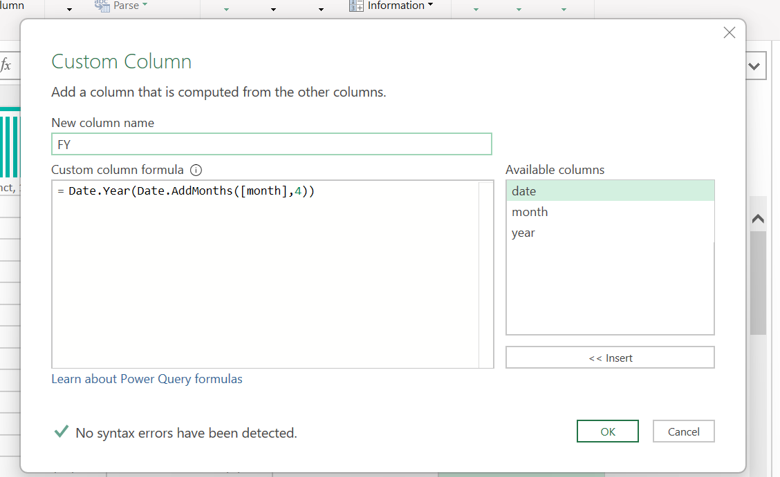
Adding Date table using Power Query and converting calendar year to Fiscal Year
The date table has been created by extracting the date range form the fact sales monthly table
Converting Calendar Year to Fiscal Year
The fiscal year obtained by adding 4 more months to the month column and then extracting the year from the new column
*Fiscal Year for AtliQ starts from september 1st till the end of Aug next year

Slide 7
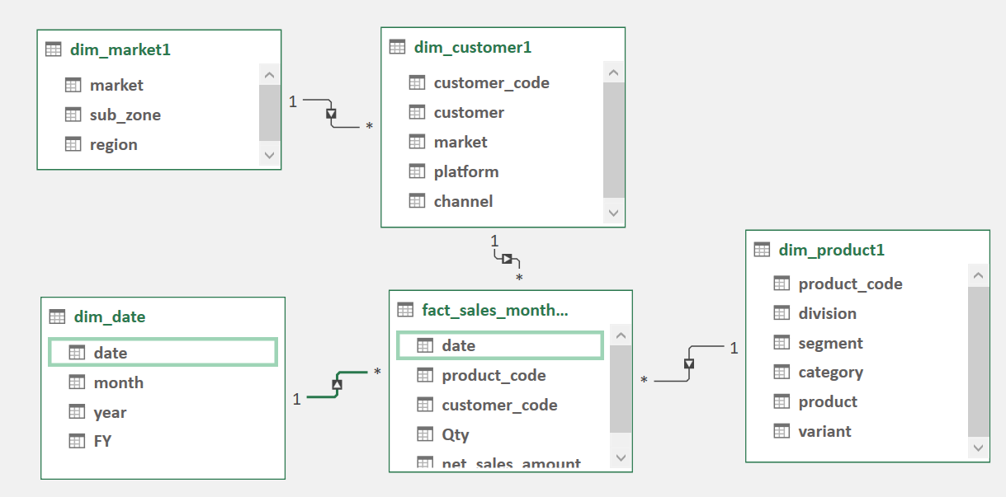
Creating Connections among Tables using Data Modeling
fact_sales_monthly table joined with dim_product table on product code column
fact_sales_monthly table joined with dim_customer table on customer code column
dim_customer table joined with dim_market table on market column
fact_sales_monthly table joined with dim_date table on date column

Slide 8
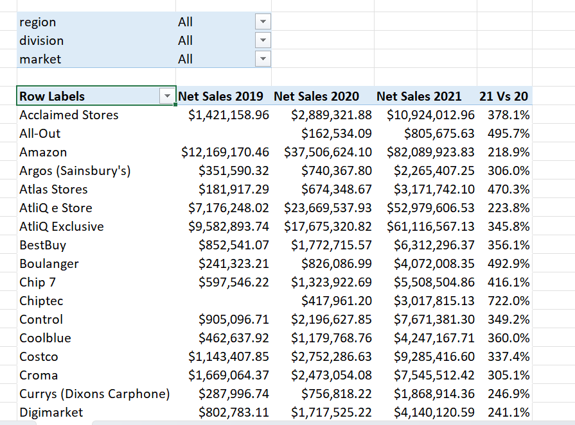
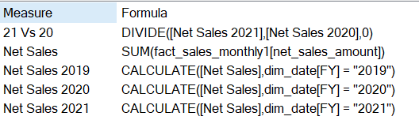
Sales Analytics: Creating Customer Performance Report
Created the report using the Power Pivot feature of Excel
The yearly sales figures are calculated features created using DAX language

Slide 9
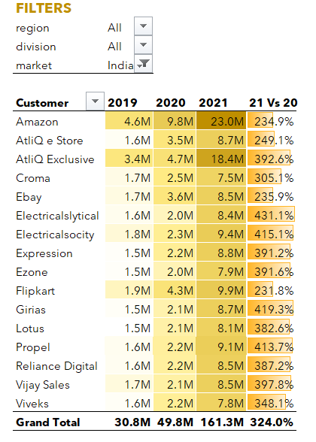
Final Dashboard after number, text and color formatting

